Slide 1
BREAD AND BYTES
Members:
Khushi Varshney (191500398)
Shivani (191500768)

Slide 2
Outline :
About the project
Objective
Problem Statement
Motivation
Requirements
What is Stock Management ?
Use case Diagram
Data Flow Diagram
Snapshots from the website
Future Scope
Conclusion

Slide 3
About the Project :
The snacks shop management system is website which is based on ordering and selling the snacks and generating bills. The main principle behind this project is easy supervision of job. It has user friendly and modular approach. The record of each customer is stored in form of bills generated , next the item is selected , quantity and descriptions are also added. At the end of the day report is generated to calculate the payment per day.

Slide 4
Objective
The main objective is to computerize the process of ordering and generating bill of the shop.
In other words we can say that our project has following objectives:
Make all the system computerize, means no paper work.
Reduce time consumption.
Simple database is maintained.
Admin module is available in the websites.
There is a facility of adding new category , new product and updating rates of product depending upon admin.

Slide 5
Problem Statement
It provides online service committed to help you make wise and profitable decisions related to untrusted accountants , managers and clerks.
The Snacks Shop Management System is a simple web-based application platform for snacks shops that can help them to manage their stocks and day-to-day transaction with their customers.
This automated platform was developed using PHP/OOP and MySQL Database.
It allows the management to store their product stocks and has a POS Feature.

Slide 6
Motivation:
The primary purpose of this snacks shop management system is to ensure there is enough goods or materials to meet demand without creating overstock. This application would keep a proper track of stocks , sales and purchases . It would help the admin to save money by firing a accountant or a person specifically hired to manage stocks and sales and also profit them financially . This system eliminates the use of paper , hence , saving nature .

Slide 7
Requirements :
Hardware Requirements :
Processor : Intel i3
Operating System : Windows 7/8/10
RAM : 4+ GB
Hardware Devices : Computer System
Hard disk : 64 GB
Display : 1366 x 768

Slide 8
Software Requirements :
Web Browser : Chrome
Software required – xampp, VS studio.
Implemented – Front-end and Back-end technologies.

Slide 9
What is Stock Management?
It is a practice of planning about buying ,storing and selling of stock whether it’s raw materials , parts or finished goods – to ensure the right type and amount of stock is available without holding excess stock and thereby tying up cash. When done correctly, it saves company’s money.

Slide 10
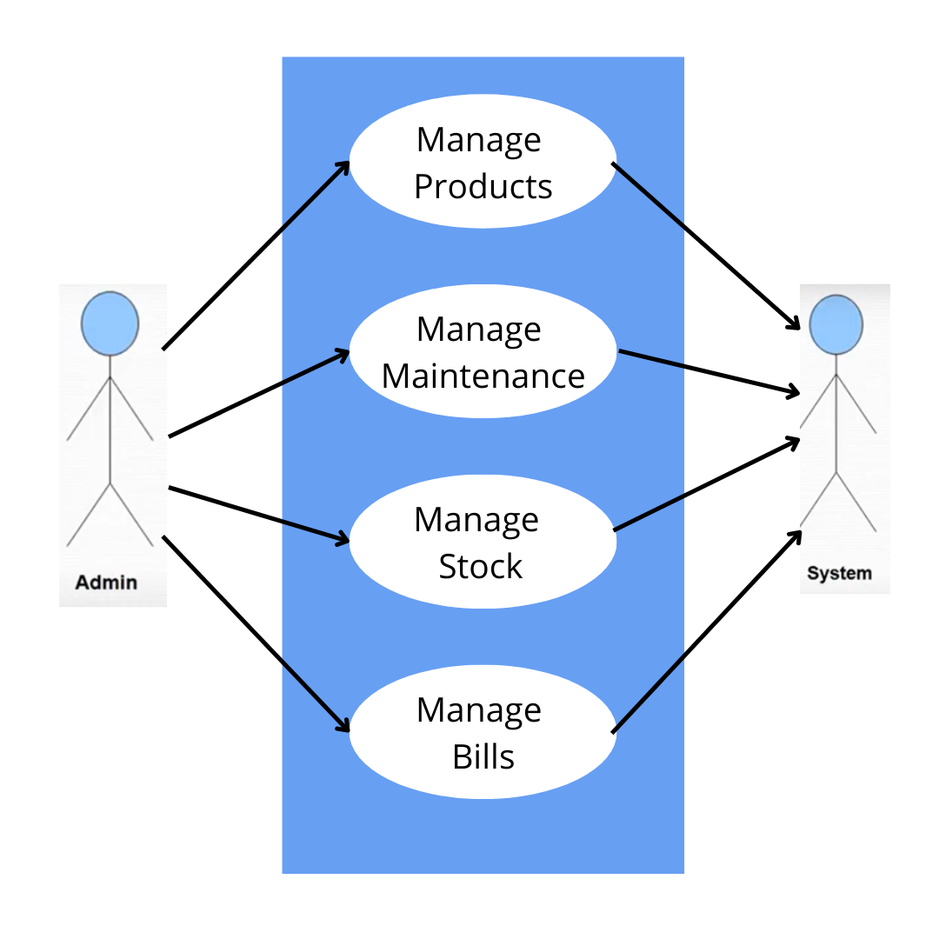
Use Case Diagram :

Slide 11
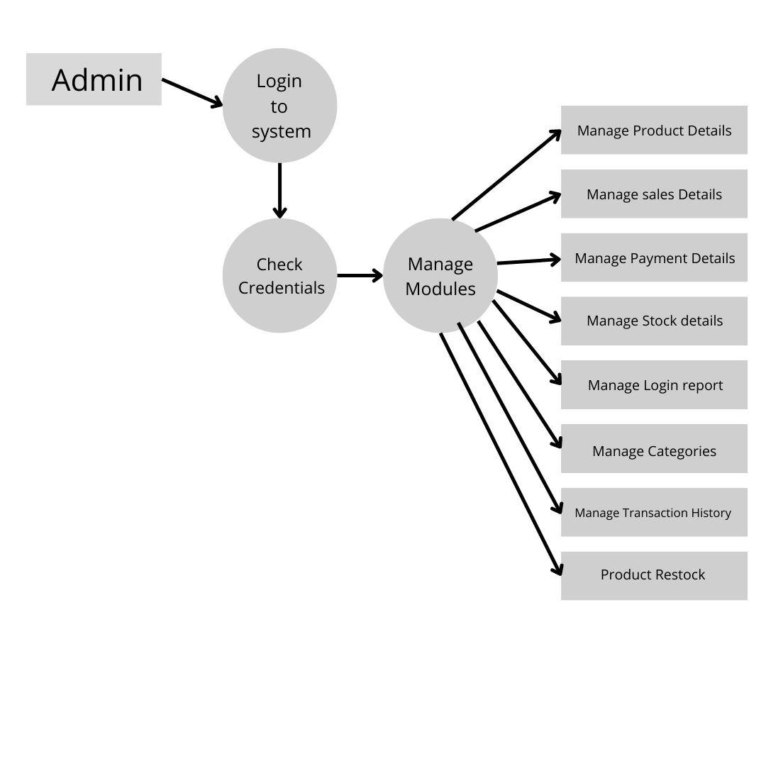
Data Flow Diagram

Slide 12
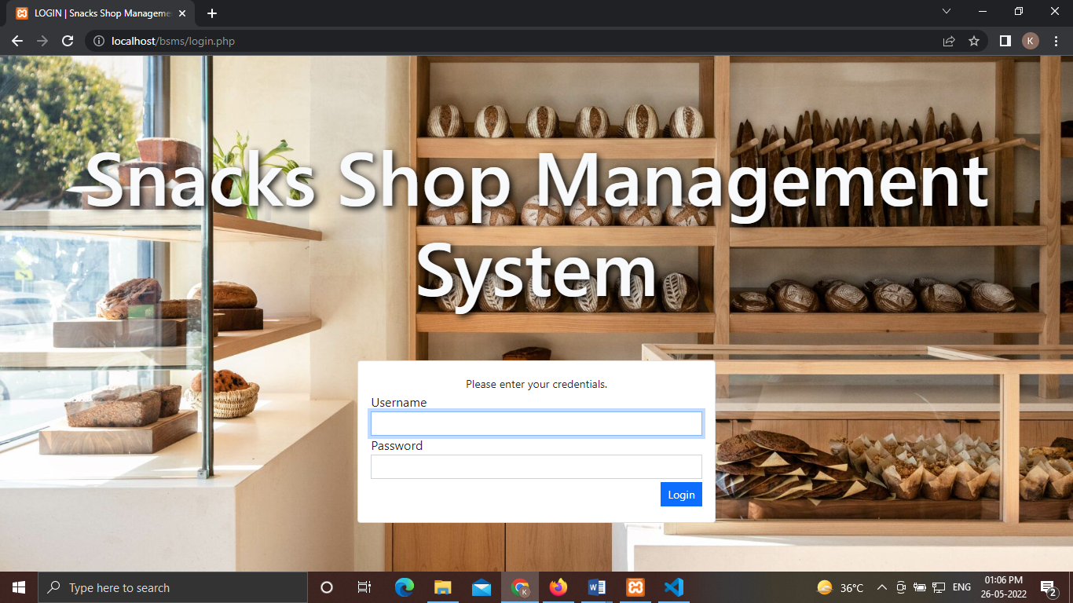
A Glance of our website
Welcome page

Slide 13
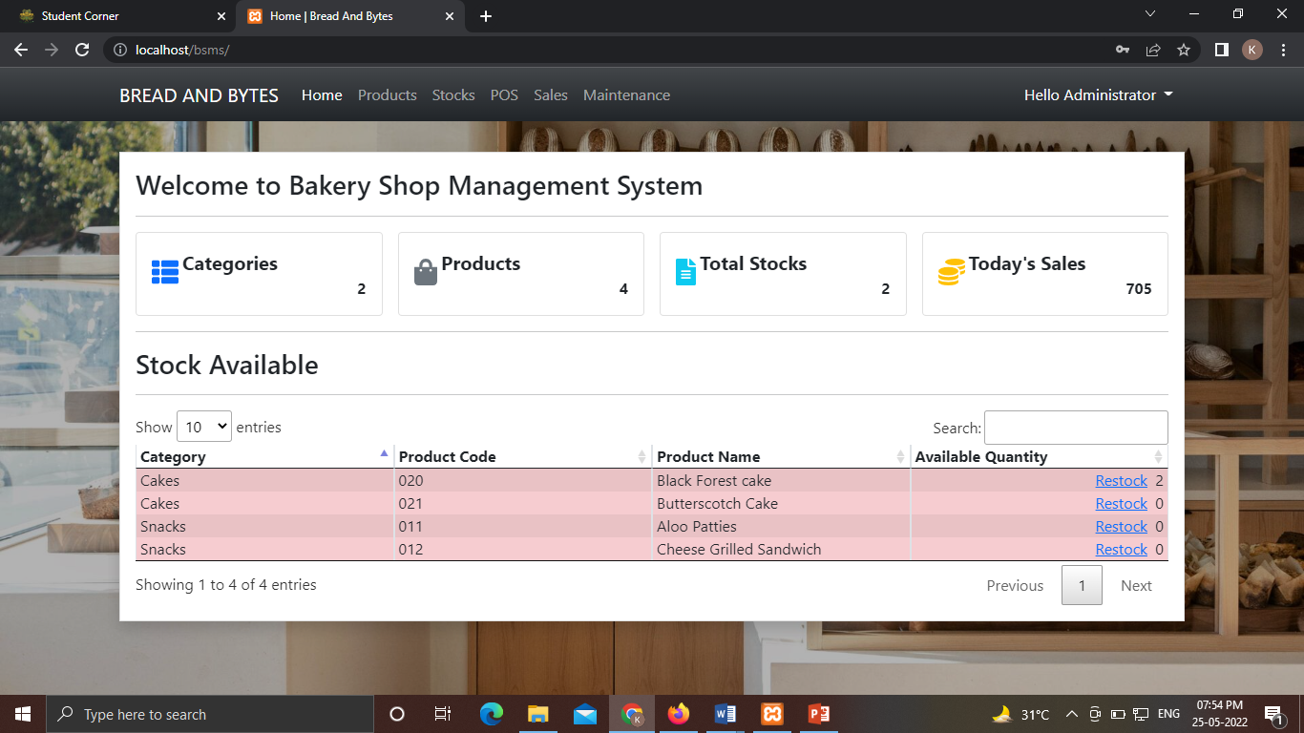
Main Page

Slide 14
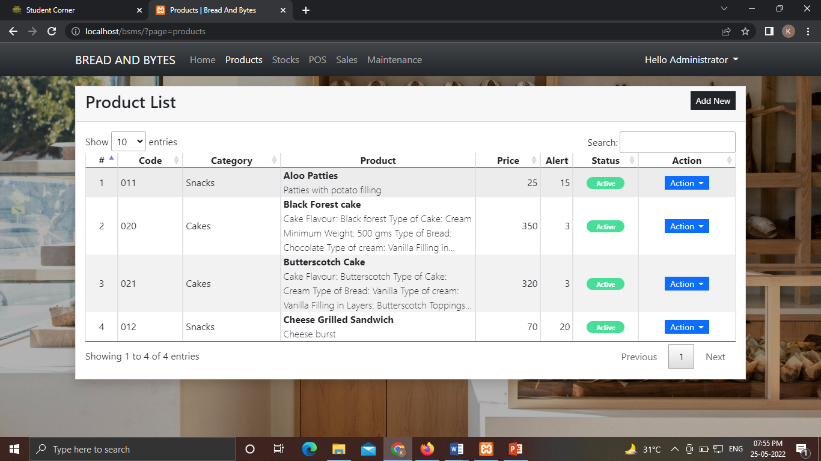
Navigating through the Navbar :
a) Products

Slide 15
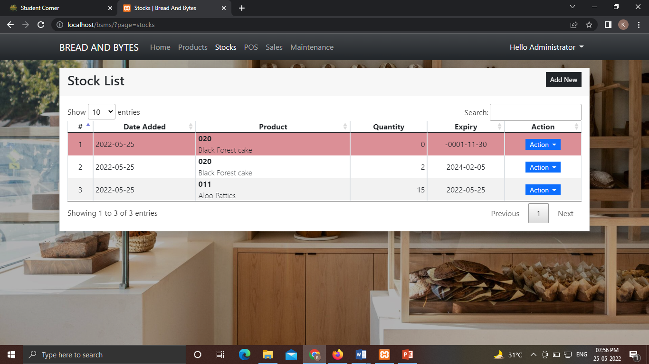
b) Stocks

Slide 16
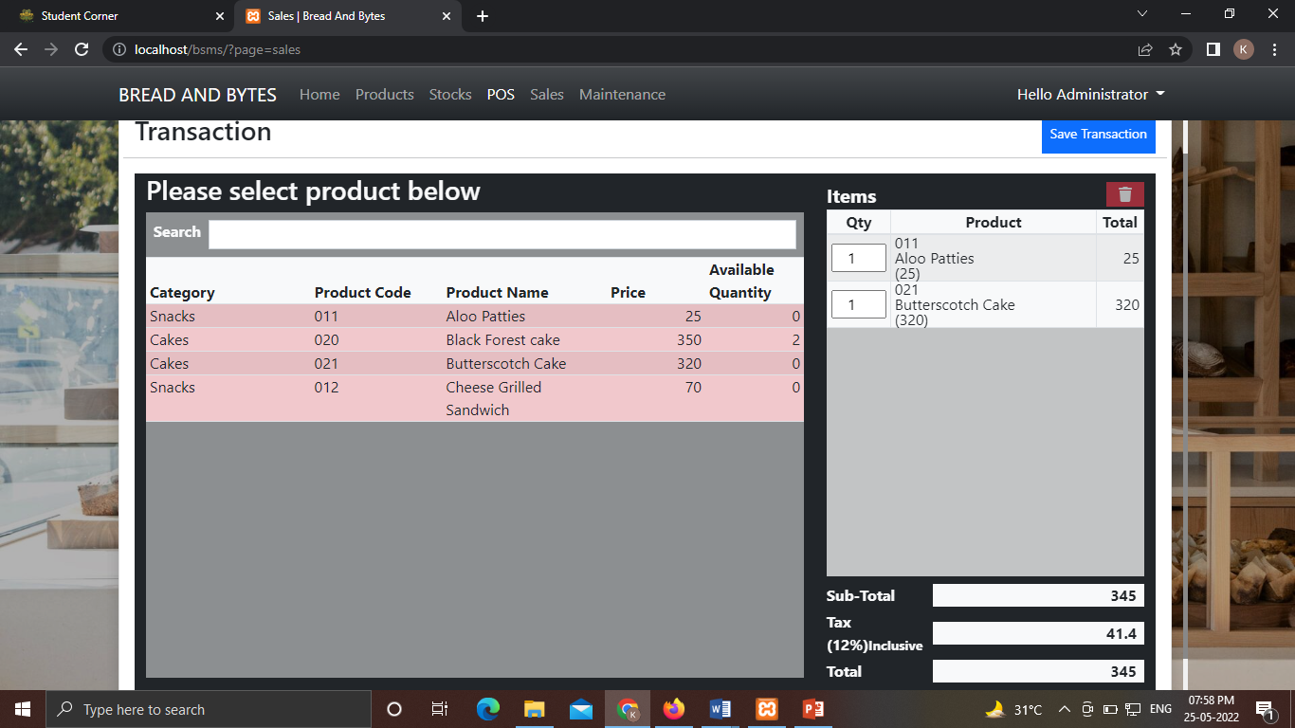
c) POS

Slide 17
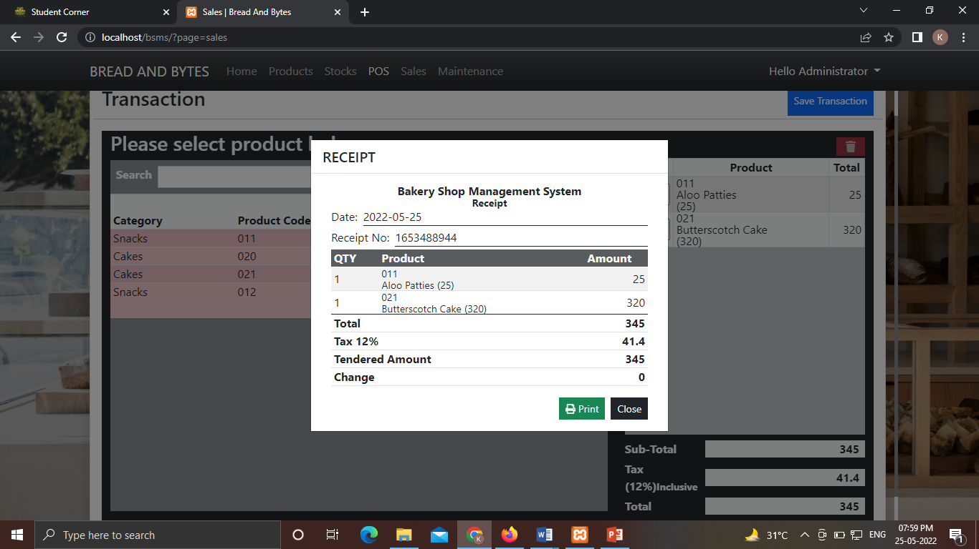
d) Sales

Slide 18
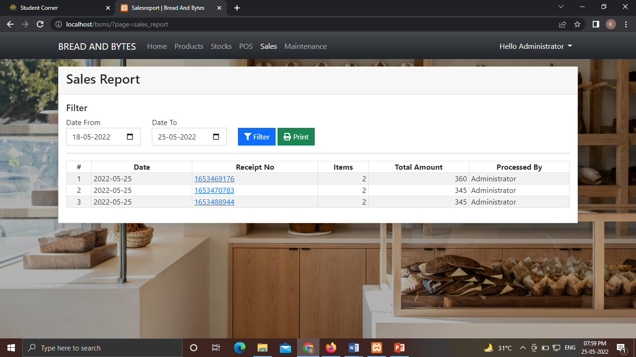

Slide 19
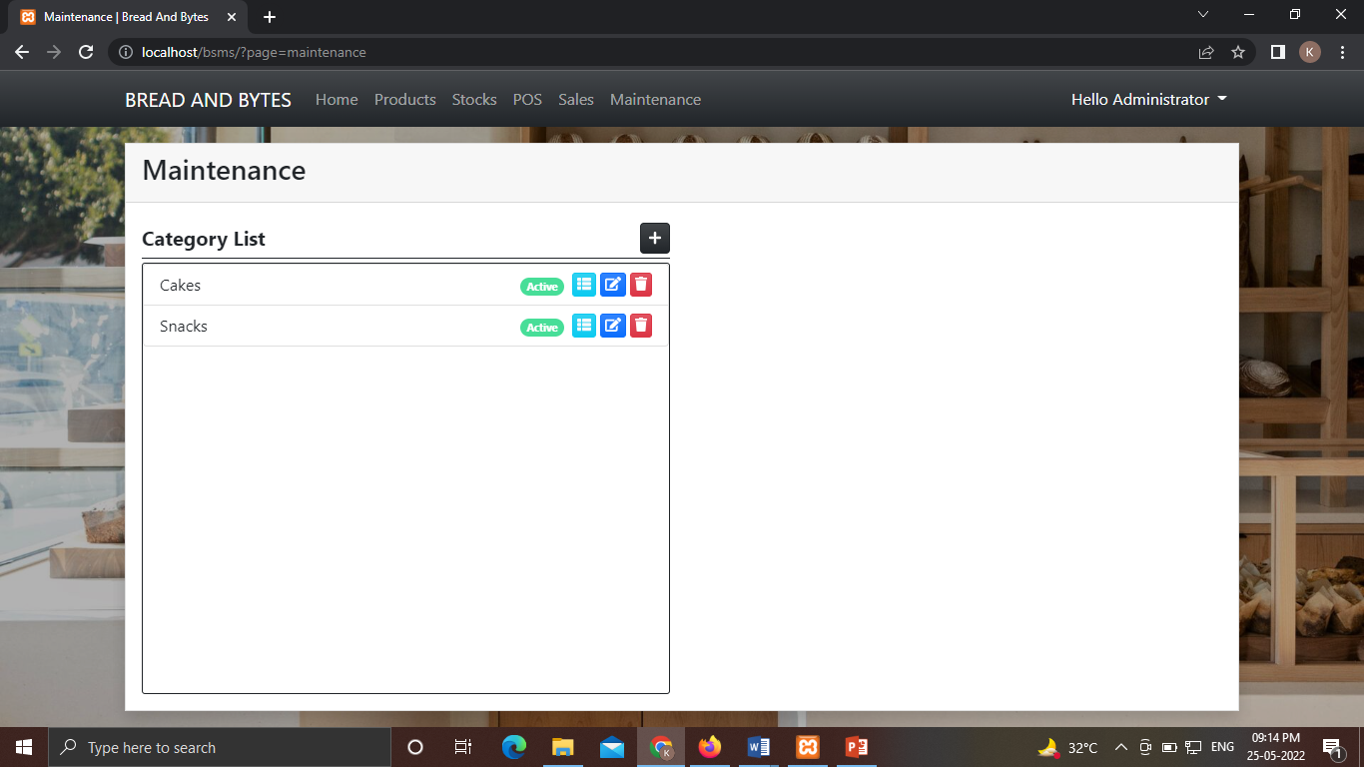
e) Maintenance

Slide 20
Future Scope
We can also make an android application for this website.
More graphics can be added to make it more user-friendly and understandable.
A chatbot for queries can be made for the website.
More secured Application can be created.

Slide 21
Conclusion:
In whole procedure to prepare project, we first gather the requirement of the project and then try to overcome all the fallbacks after implementation. After this, we are able to work with a team in order of the creation of the web application. And we have completed our project within time limit with the coordination of our team members under the supervision of our mentor Mr. Mandeep Singh.

